Slide 1
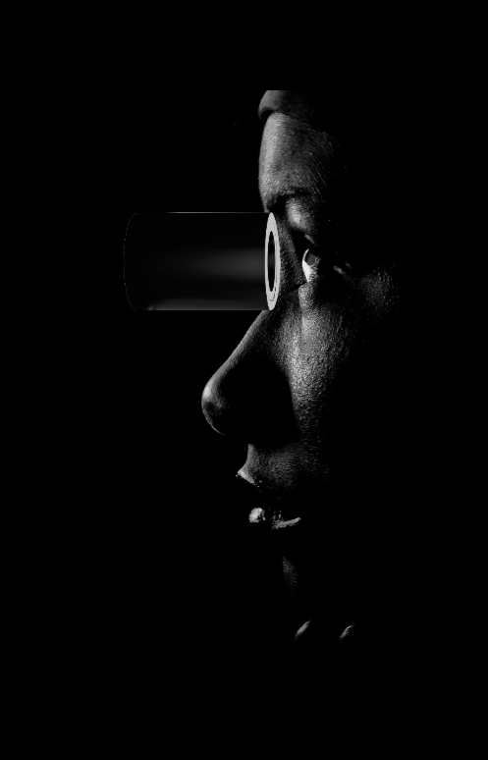

Making innovative, affordable eye care accessible to everyone.
Presenter: Rania Maklad CEO & Co-Founder
Financial Disclosure: Equity holder in OCUWELL
iNovation 2025
CONFIDENTIAL AND PROPRIATERY
Any use of this material without specific permission of OCUWELL Ltd is strictly prohibited

Slide 2
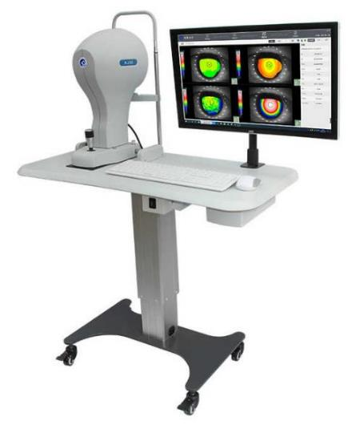
Clinical Gap & Need
No cloud integration; manual updates and maintenance required.
Millions of patients underserved, especially paediatric and bedbound.
Limited access for community optometrists and domiciliary care.
Bulky
£12k- £50k
OCUWELL bridges this gap with portability, affordability, and accessibility
Clinic Bound

Slide 3
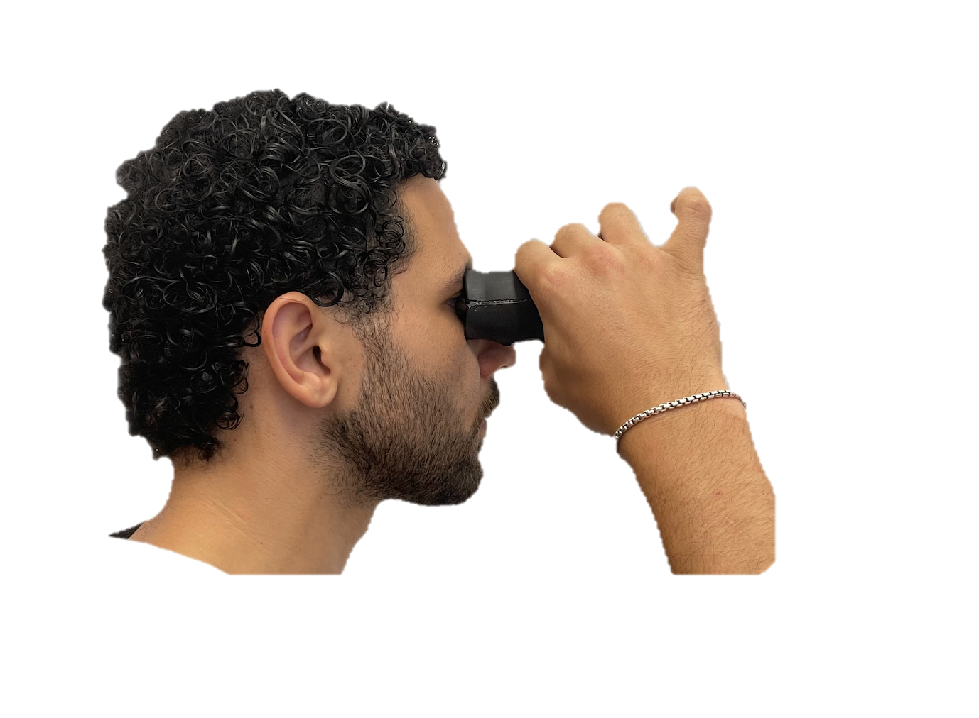
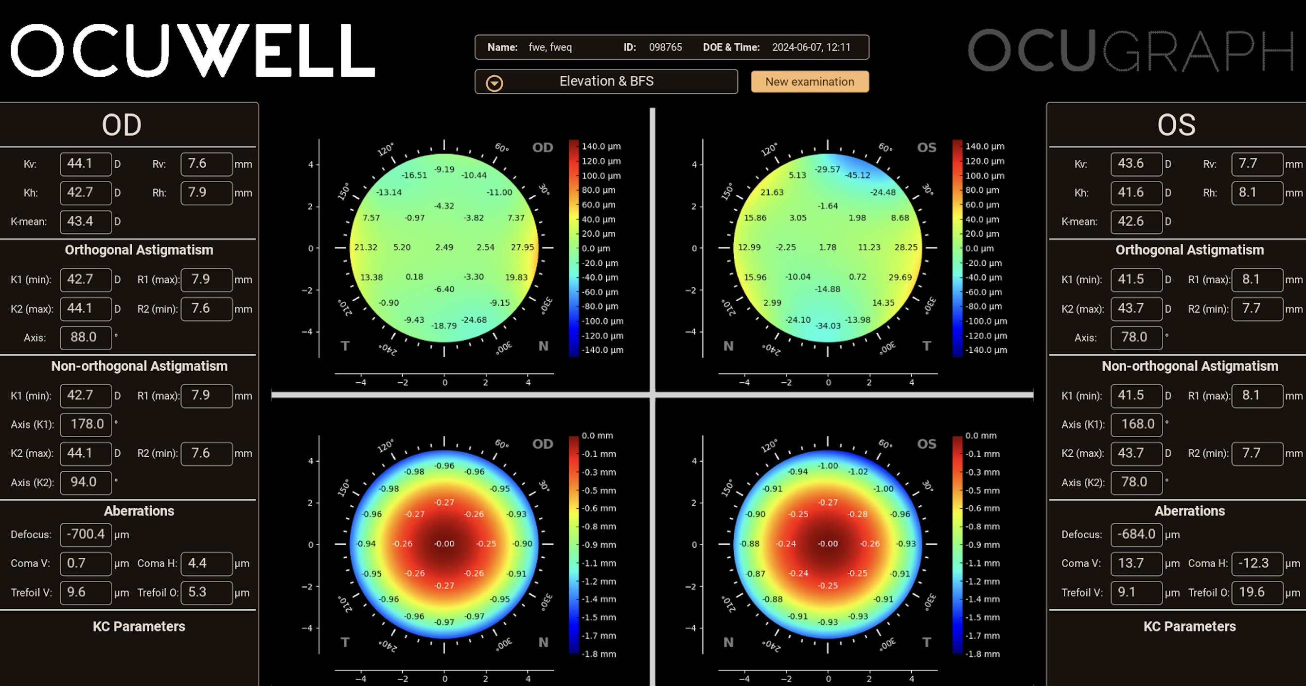
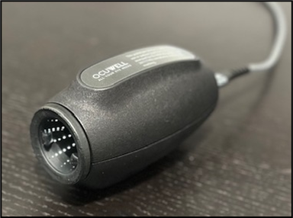
Our Solution – OCUTOP® & OCUGRAPH®
Detection
Receive feedback
Take photo
Contact lens fitting
Surgical Planning
£4000
80gms 8cm by 5cm
Cloud based
Redefining global access to corneal diagnostics
Compatible with Smart Phones

Slide 4

Product Developments & Regulatory Pathway
Validated Prototype,
£1.4m Grant funding
Seed funding £700k
Manufacturing Partnership
Series A funds £2m
USA FDA submission
UKCA Submission: Q4 2025
CE Submission: Q3 2026
UK sales
EU sales
India sales
New device
In 2 years we’ll release another device and double our software modules.
In 5 years, we’re aiming for 4 devices and a platform with a range of modules to support eye health care for the cornea and beyond

Slide 5

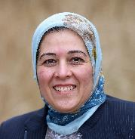
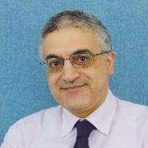
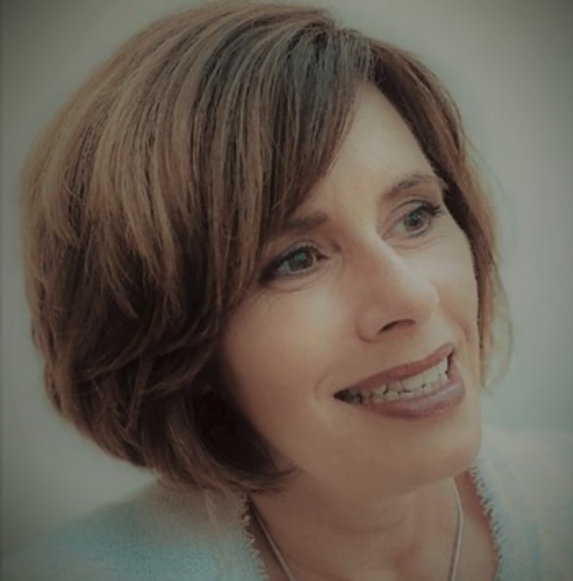

Business & Next Steps
www.ocuwell.com info@ocuwell.com
Market Opportunity:
UK: 23k optometrists → EU (75k) → USA (46k) → Emerging markets.
Team: Multidisciplinary founders + global clinical advisors.
Business Model:
  Device £4k (40% distributor margin, £228 cost)
  SaaS £25–50/month per module, scalable
Mrs Rania Maklad
CEO
Prof Ahmed Elsheikh
CSO
Dr Joanne Phoenix
Chair
Business management expert
Ocular biomechanics leader
Specialist business consultant
Funding: £2M raise → approvals, launch, scale
Mission:
Making advanced corneal diagnostics accessible worldwide.

